Slide 1

Introduction
David Quigley
CSCI 4622
2023 Spring

Slide 2

About Me
Dr. David Quigley (You can call me David or Dr. Quigley)
Assistant Teaching Professor, Dept. of Computer Science
10th year at CU (5th year post-graduate)
Applied Machine Learning Research:
Studying the way students use digital tools for learning
- Student use of LMS
- Student Scientific Modeling
- Students Reading to Learn
- Students’ epistemological beliefs on the nature of science

Slide 3
About the Course Staff
Ayoub Ghriss - TA

Slide 4
About You
Post an introduction on Piazza in the “Personal Introductions” discussion! Share as much or as little as you want (but I want everyone to post, to make sure everyone can access, use Piazza).
(This is a participation grade, due by Wednesday 1/25)

Slide 5
Class Resources
Computing Device
- Laptop recommended, any OS (ish)
Course Canvas Website
canvas.colorado.edu
Python 3 (with external packages)
- Google Colab as a default https://colab.research.google.com/
- Anaconda recommended https://www.anaconda.com/download/
“Dumb” Calculator

Slide 6
Course Logistics
Weekly Participation– Expected Weekly
- Weekly activities have already begun to appear (Piazza Introduction)
- Weekly Participation = 10% of Grade
Assignments (Problem Sets / Homeworks) – Every 2 - 3 Weeks
- See collaboration policy, submission deadlines
- Problem Sets = 30% of Grade
Midterms – Approximately every 7 – 8 weeks
- Already on the Calendar
- Specifics outlined in the week or two before the exam
- Midterms = 30% of Grade
Project Updates - Every 3 – 5 weeks (not synced with midterms)
- Be on the lookout for team information
- Projects = 30% of Grade

Slide 7
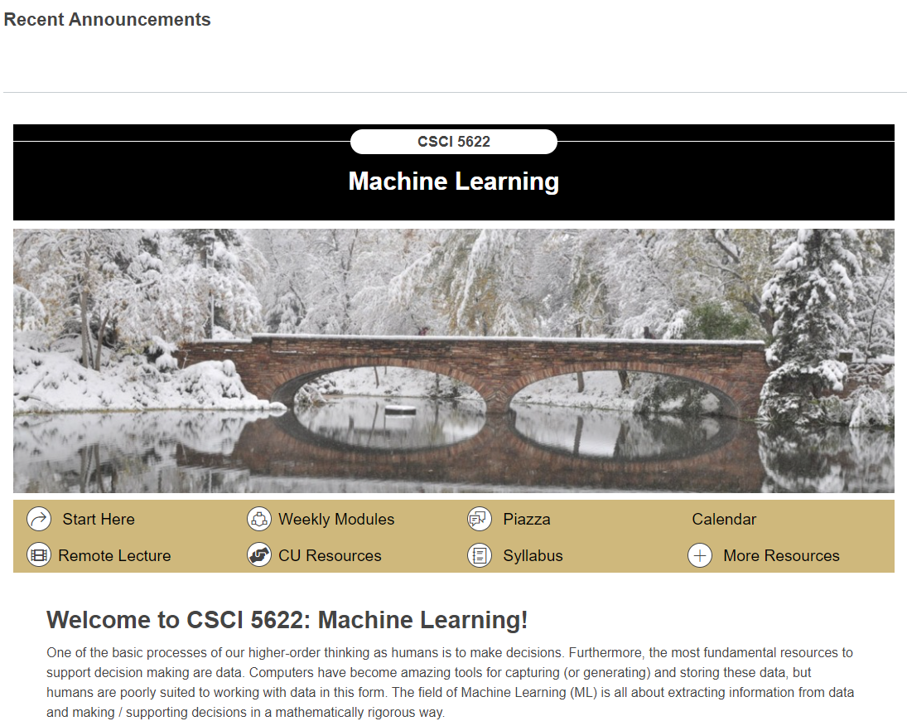
Course Logistics

Slide 8
Course Functionality – Campus Protocols
Rule #1 – We will be following all campus rules and guidelines for instruction.
Mask Policies (currently optional)
Campus Closures (Weather, etc.)
Flexibility – Life happens, and you can have an interruption while keeping up with class
Participation will be over time
OH are a good time to review missed materials – you can make them “by appointment”

Slide 9
Course Functionality
I may occasionally have to adjust class for everyone’s safety.
Try to set up your notifications to see Canvas and / or Piazza notifications.

Slide 10
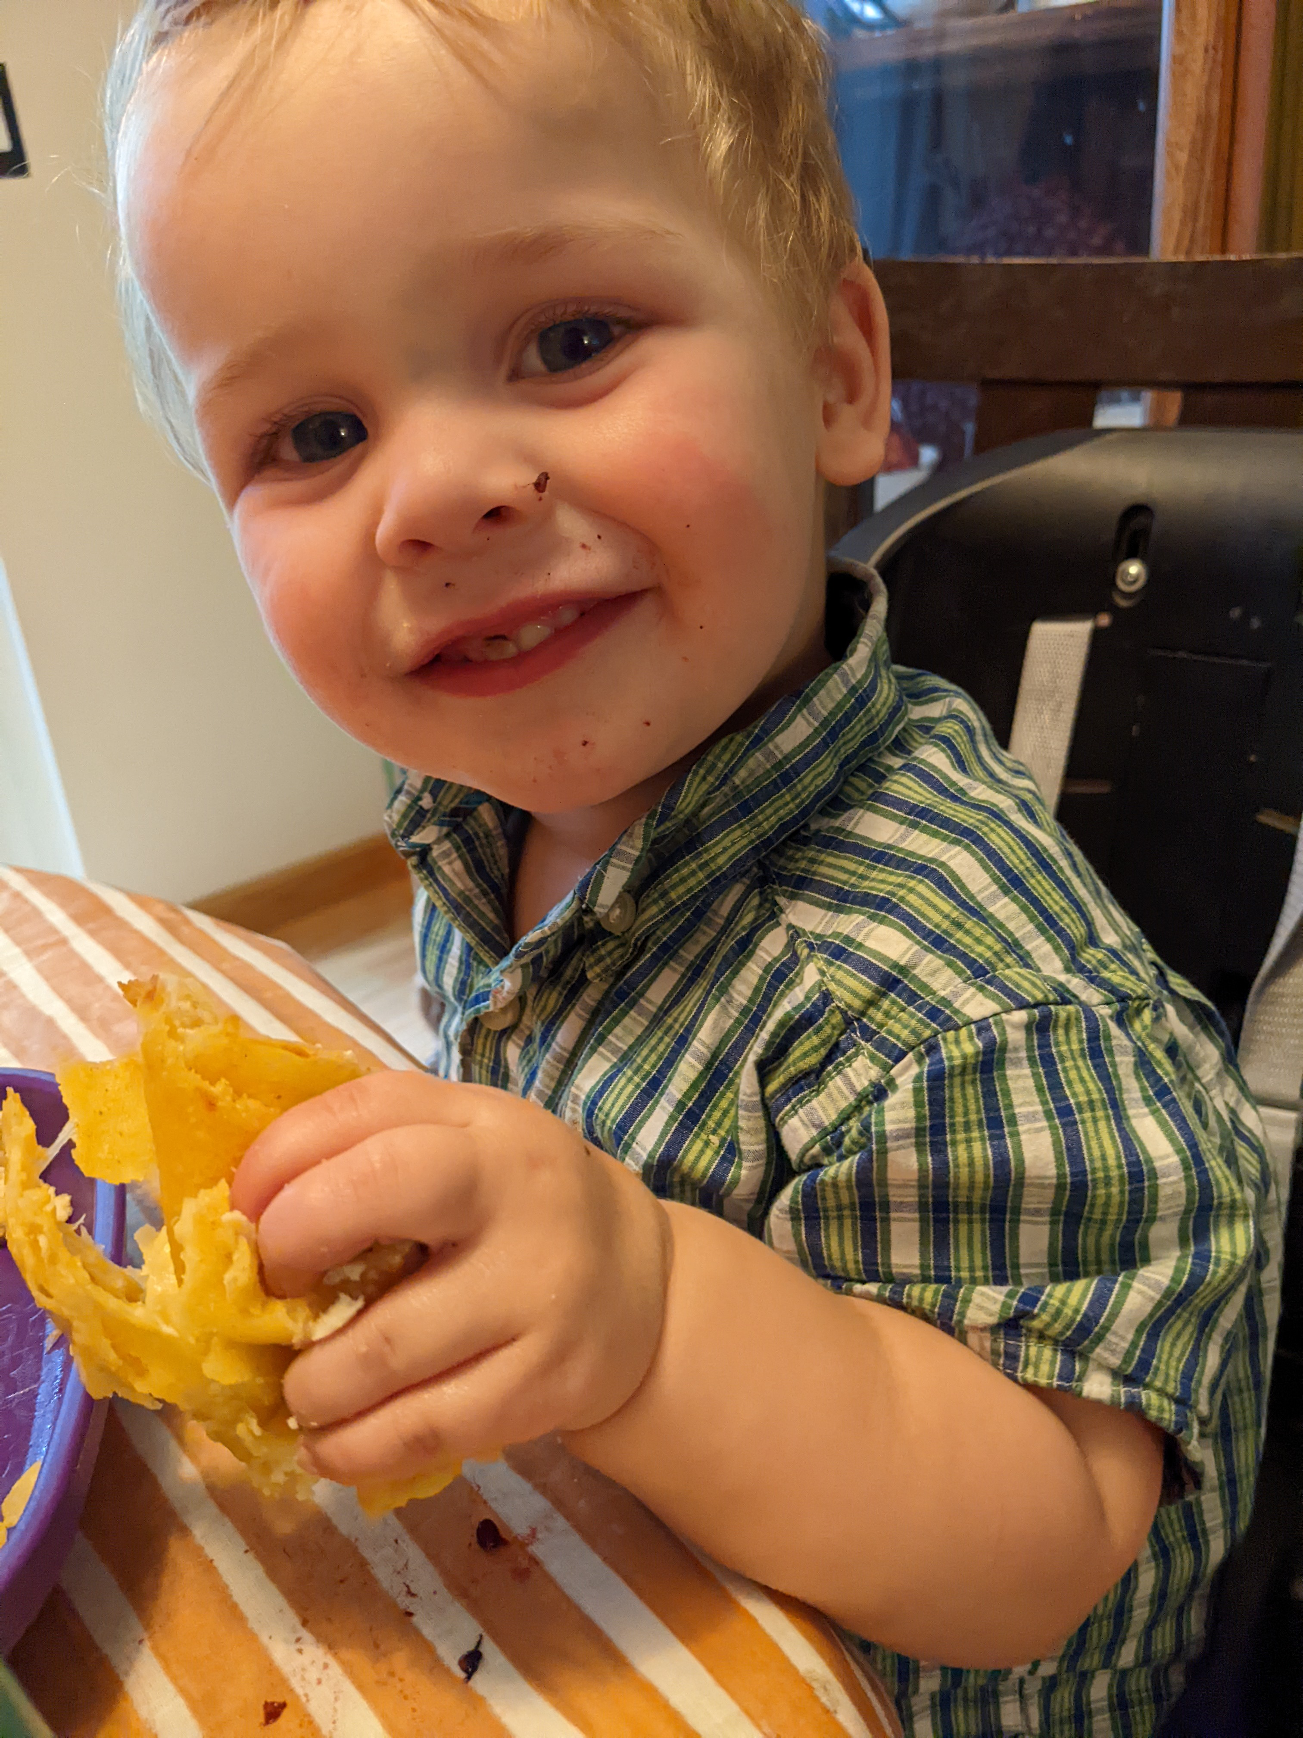
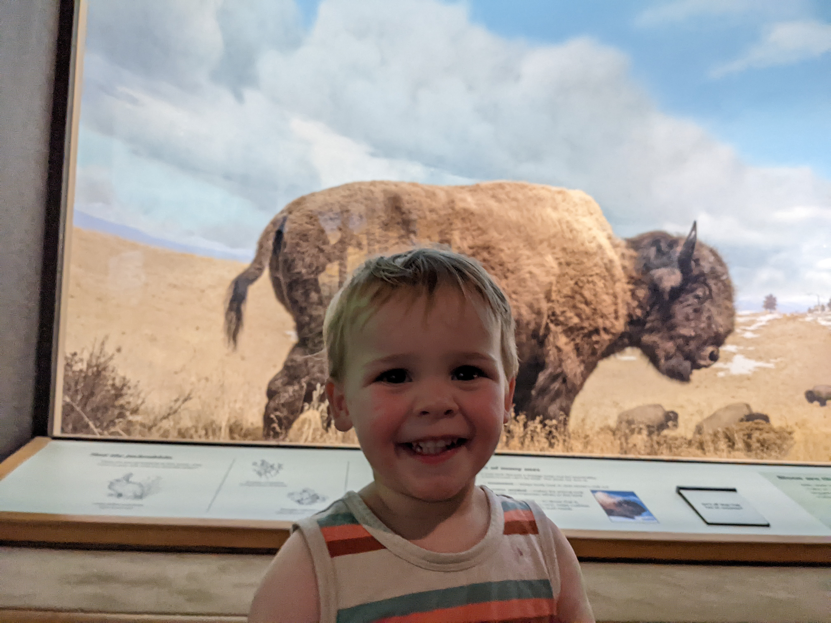
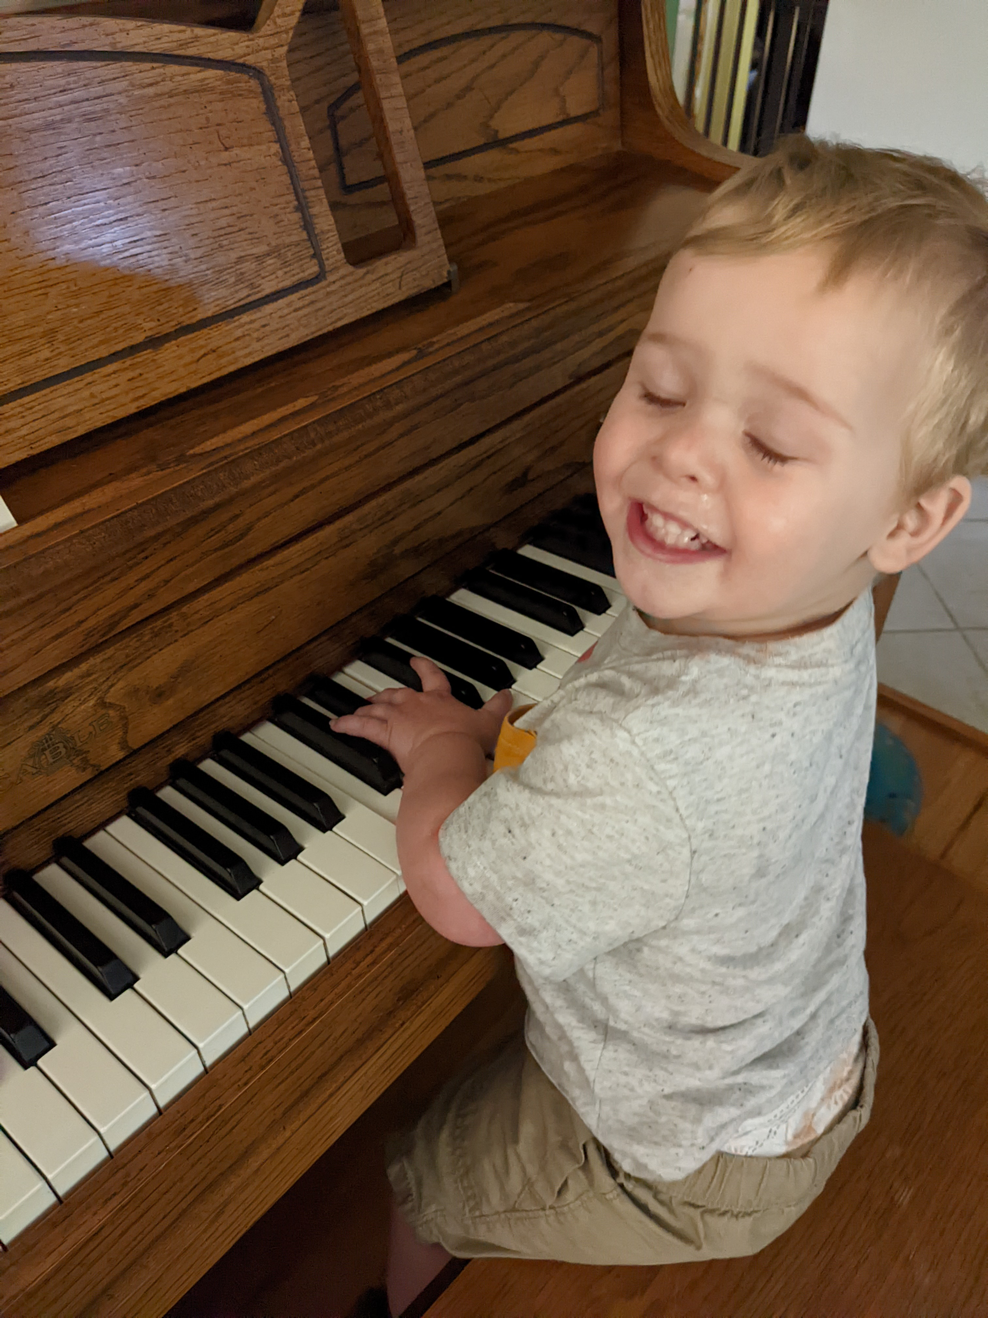
Course Functionality
I may occasionally have to adjust class for everyone’s safety.
Try to set up your notifications to see Canvas and / or Piazza notifications.

Slide 11

Course Logistics
Weekly Activity – Piazza Introduction
Due Monday, January 23 @ 11:25 PM (i.e. before class)
Problem Set 1 – releases Next Week!
Due Monday, February 6 @ 11:59 PM (i.e. as late as possible)
Orienting yourself to the syllabus, calendar, weekly modules, etc.
Maybe you’ve started doing course readings? That’d be great!
Don’t get too far ahead on course readings - you’ll get yourself lost!

Slide 12
Goals for this Course (see syllabus)
Explain a problem from an ML perspective
Select which ML techniques and approaches are best suited to your problem
Prepare your data to implement the chosen approach
Apply your ML approach to generate a solution
Evaluate the results of your solution and share them with others
Implement common solutions in Python

Slide 13
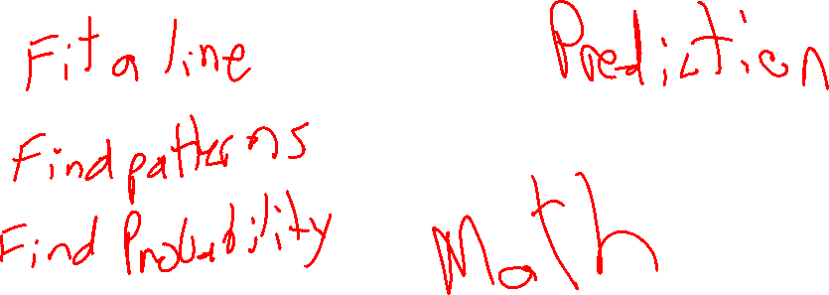
What is Machine Learning (ML)?

Slide 14
What is ML? Through History…
Arthur Samuel (1959) - Machine Learning: Field of study that gives computers the ability to learn without being explicitly programmed.
Notes:
https://en.wikipedia.org/wiki/Arthur_Samuel
https://www.ibm.com/developerworks/community/blogs/jfp/entry/What_Is_Machine_Learning?lang=en

Slide 15
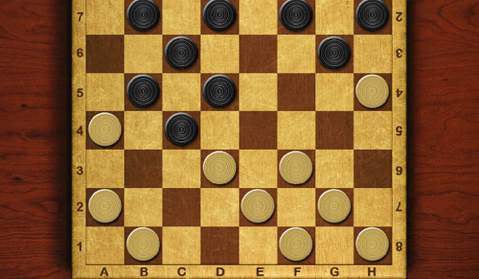
Notes:
https://www.coolmathgames.com/sites/cmatgame/files/checkers.jpg

Slide 16
What is ML? Through History…
Well-Posed Learning Problem (Tom Mitchell, 1998) - A computer program is said to learn from experience E with respect to some class of tasks T and performance measure P, if its performance at tasks in T, as measured by P, improves with experience E.
Notes:
https://www.cs.ubbcluj.ro/~gabis/ml/ml-books/McGrawHill%20-%20Machine%20Learning%20-Tom%20Mitchell.pdf

Slide 17

What is “Task”?
Notes:
https://www.popsci.com/sites/popsci.com/files/styles/1000_1x_/public/import/2013/images/2013/01/redditpage.png?itok=QYzbZlH7

Slide 18
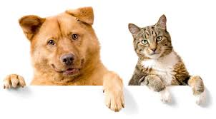
What is “Task”?
Notes:
https://www.popsci.com/sites/popsci.com/files/styles/1000_1x_/public/import/2013/images/2013/01/redditpage.png?itok=QYzbZlH7
https://c.o0bg.com/rf/image_960w/Boston/2011-2020/2015/06/02/BostonGlobe.com/Magazine/Images/shutterstock_15484942-1837.jpg

Slide 19
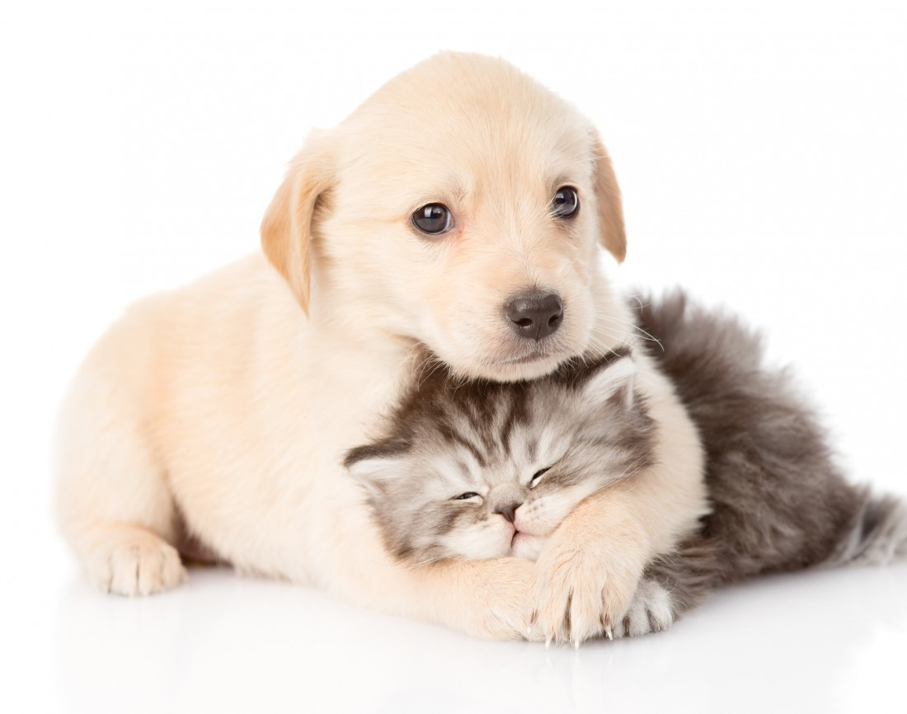
What is “Task”?
Notes:
https://www.popsci.com/sites/popsci.com/files/styles/1000_1x_/public/import/2013/images/2013/01/redditpage.png?itok=QYzbZlH7
https://c.o0bg.com/rf/image_960w/Boston/2011-2020/2015/06/02/BostonGlobe.com/Magazine/Images/shutterstock_15484942-1837.jpg
http://gimmeinfo.com/wp-content/uploads/2016/02/pets-cat-dog-2-1100x866.jpg

Slide 20
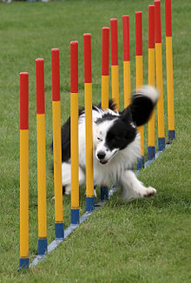
What is “Task”?
Notes:
https://www.popsci.com/sites/popsci.com/files/styles/1000_1x_/public/import/2013/images/2013/01/redditpage.png?itok=QYzbZlH7
https://c.o0bg.com/rf/image_960w/Boston/2011-2020/2015/06/02/BostonGlobe.com/Magazine/Images/shutterstock_15484942-1837.jpg
http://gimmeinfo.com/wp-content/uploads/2016/02/pets-cat-dog-2-1100x866.jpg
https://upload.wikimedia.org/wikipedia/commons/thumb/d/d2/Border_collie_weave_poles.jpg/220px-Border_collie_weave_poles.jpg

Slide 21

What is “Task”?
Notes:
https://www.popsci.com/sites/popsci.com/files/styles/1000_1x_/public/import/2013/images/2013/01/redditpage.png?itok=QYzbZlH7
https://c.o0bg.com/rf/image_960w/Boston/2011-2020/2015/06/02/BostonGlobe.com/Magazine/Images/shutterstock_15484942-1837.jpg
http://gimmeinfo.com/wp-content/uploads/2016/02/pets-cat-dog-2-1100x866.jpg
https://upload.wikimedia.org/wikipedia/commons/thumb/d/d2/Border_collie_weave_poles.jpg/220px-Border_collie_weave_poles.jpg
https://d38kx05og7618t.cloudfront.net/uploads/sites/4/2016/01/iStock_000024526236_Medium.jpg

Slide 22
What is ML? Through History…
Well-Posed Learning Problem (Tom Mitchell, 1998) - A computer program is said to learn from experience E with respect to some class of tasks T and performance measure P, if its performance at tasks in T, as measured by P, improves with experience E.
Notes:
https://www.cs.ubbcluj.ro/~gabis/ml/ml-books/McGrawHill%20-%20Machine%20Learning%20-Tom%20Mitchell.pdf

Slide 23

What is “Experience”?

Slide 24
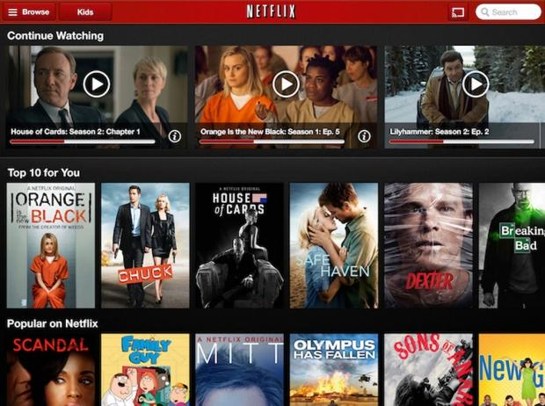
What is “Experience”?
Notes:
http://rejoiner.com/resources/wp-content/uploads/2016/06/reco-based-purchase.png
https://imagescdn.tweaktown.com/news/3/7/37841_6_netflix_eyes_new_navigation_scheme_for_the_future.jpg
http://www.sciepub.com/images/22.png

Slide 25
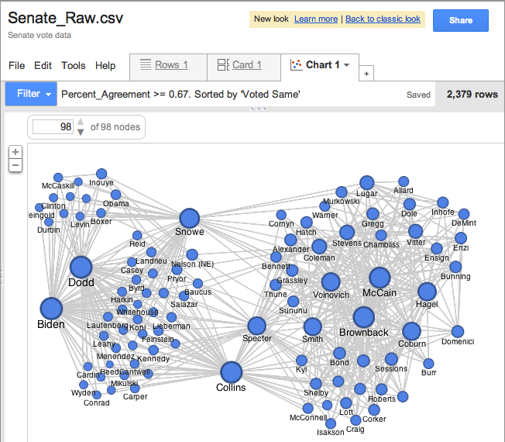
What is “Experience”?
Notes:
https://storage.googleapis.com/support-kms-prod/SNP_2754043_en_v0

Slide 26

What is “Experience”?
Notes:
http://rejoiner.com/resources/wp-content/uploads/2016/06/reco-based-purchase.png
https://imagescdn.tweaktown.com/news/3/7/37841_6_netflix_eyes_new_navigation_scheme_for_the_future.jpg
https://storage.googleapis.com/support-kms-prod/SNP_2754043_en_v0 http://www.sciepub.com/images/22.png

Slide 27
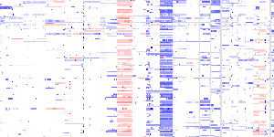
What is “Experience”?
Notes:
http://rejoiner.com/resources/wp-content/uploads/2016/06/reco-based-purchase.png
https://imagescdn.tweaktown.com/news/3/7/37841_6_netflix_eyes_new_navigation_scheme_for_the_future.jpg
https://storage.googleapis.com/support-kms-prod/SNP_2754043_en_v0 http://www.sciepub.com/images/22.png
https://www.broadinstitute.org/files/news/stories/full/IGV.jpg

Slide 28
What is ML? Through History…
Well-Posed Learning Problem (Tom Mitchell, 1998) - A computer program is said to learn from experience E with respect to some class of tasks T and performance measure P, if its performance at tasks in T, as measured by P, improves with experience E.
Notes:
https://www.cs.ubbcluj.ro/~gabis/ml/ml-books/McGrawHill%20-%20Machine%20Learning%20-Tom%20Mitchell.pdf

Slide 29
What is “[Improved] Performance”?

Slide 30
What is “[Improved] Performance”?

Slide 31
What is “[Improved] Performance”?
Notes:
https://mk0ehealthelets5xdjo.kinstacdn.com/wp-content/uploads/2017/12/MRI-scan-brain-tumour-300x249.jpg

Slide 32
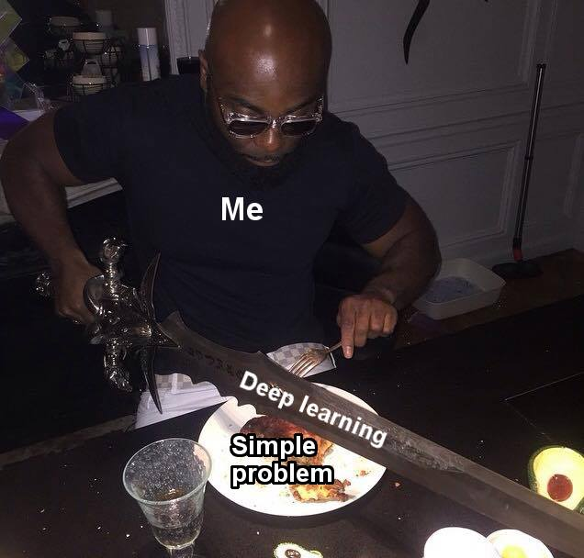
What this course isn’t – Deep Learning (5922)
We’ll cover these areas, but not in depth
Notes:
https://www.reddit.com/r/datascience/comments/ael5rz/dont_be_this_guy_xpost_from_rprogrammerhumor/

Slide 33

What this course isn’t – Data Mining (4502)
We’ll cover these areas, but not in depth
Notes:
https://www.copyrightuser.org/wp-content/uploads/2017/05/text_data_mining.jpg

Slide 34
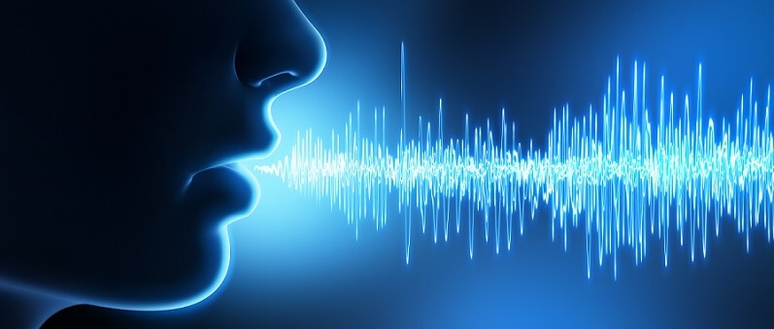
What this course isn’t – NLP (5832)
We’ll cover these areas, but not in depth
Notes:
https://www.copyrightuser.org/wp-content/uploads/2017/05/text_data_mining.jpg

Slide 35
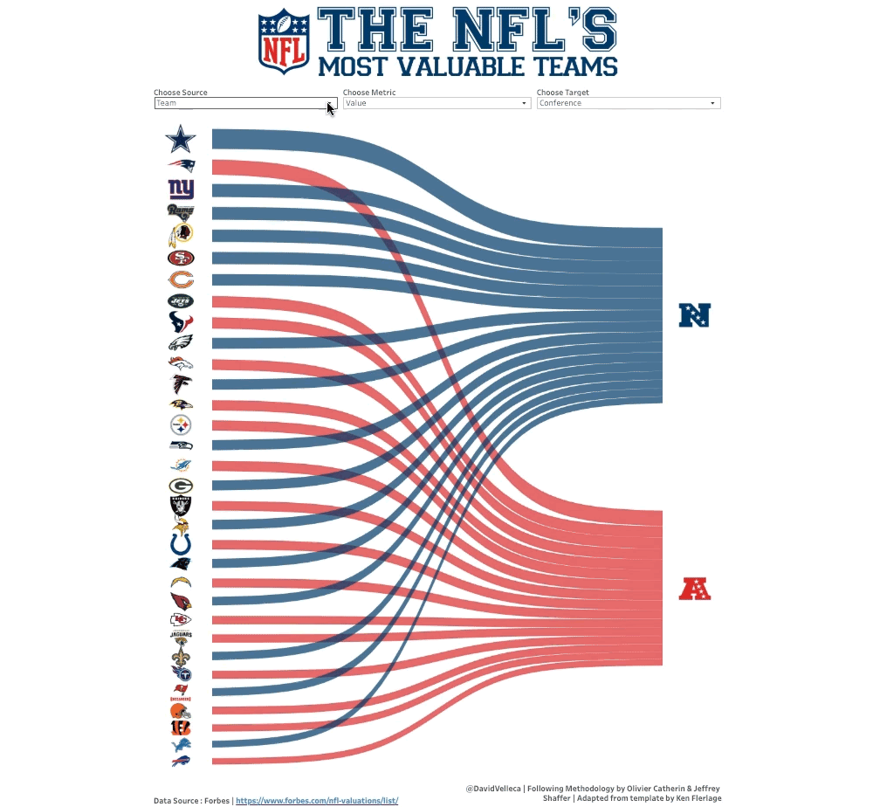
What this course isn’t – Info Viz (INFO 4602)
Notes:
https://visme.co/blog/wp-content/uploads/2019/09/information-visualization-Sankey-Diagram.gif

Slide 36
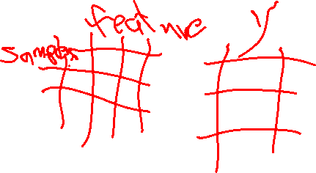
Machine Learning is Math
Data (X) → Hidden Relationship (Z) → Answer (Y)
X = (X₁, X₂, … X_{n}), each entry in X is a feature
Y is a response
Z is the mapping from features to response

Slide 37
Machine Learning is Math
Data (X) → Hidden Relationship (Z) → Answer (Y)
X = (X₁, X₂, … X_{n}), each entry in X is a feature
Y is a response
Z is the mapping from features to response
According to theory, there is a Z to map every X (of infinite size) to the real Y

Slide 38
Machine Learning is Math
Data (X) → Hidden Relationship (Z) → Answer (Y)
X = (X₁, X₂, … X_{n}), each entry in X is a feature
Y is a response
Z is the mapping from features to response
According to theory, there is a Z to map every X (of infinite size) to the real Y
Machine Learning is an approximation of Z
(Sometimes we care about trying to discover / measure the true Z, sometimes not)

Slide 39


Problem Space – Housing Market
Notes:
https://cdn.houseplans.com/product/q5qkhirat4bcjrr4rpg9fk3q94/w800x533.jpg?v=8
https://images.dwell.com/photos/6328431439726800896/6445880622670512128/large.jpg

Slide 40
Problem Space – Housing Market
X_{i} =
Y =

Slide 41

Problem Space – Housing Market
X₁ | X₂ | X₃ | X₄ | Y
Size (Sq. Ft.) | # Bed | # Bath | Year Built | Price ($)
1200 | 1 | 1.5 | 1998 | 200,000
1800 | 2 | 2 | 1985 | 450,000
800 | 1 | 1 | 2017 | 250,000
2500 | 3 | 2 | 1975 | 500,000
2800 | 4 | 2.5 | 1983 | 400,000
… | … | … | … | …

